Slide 1
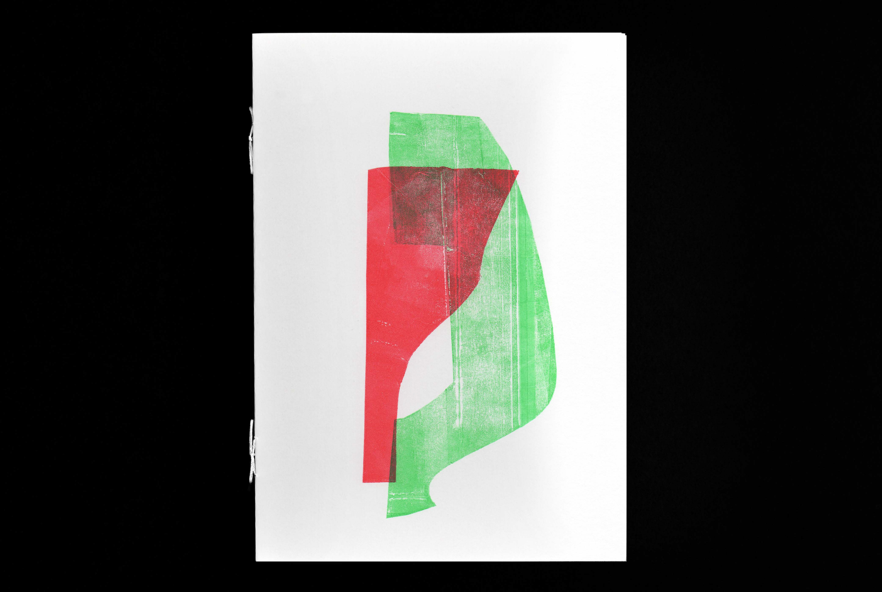






text: Myrna Renaud image: Andrea Eber t

Slide 2
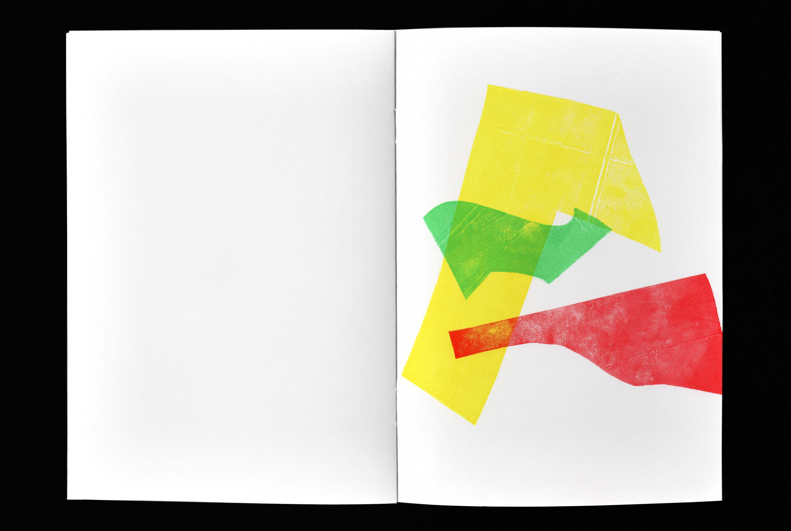
Skinny, chunky, phat, tiny or long;
my inflorescent world of shape, color and texture is ample, splayed, grounded in truth:
I have inherited the dance of Felícita and Estefanía. Women folk whispering in my left ear.

Slide 3
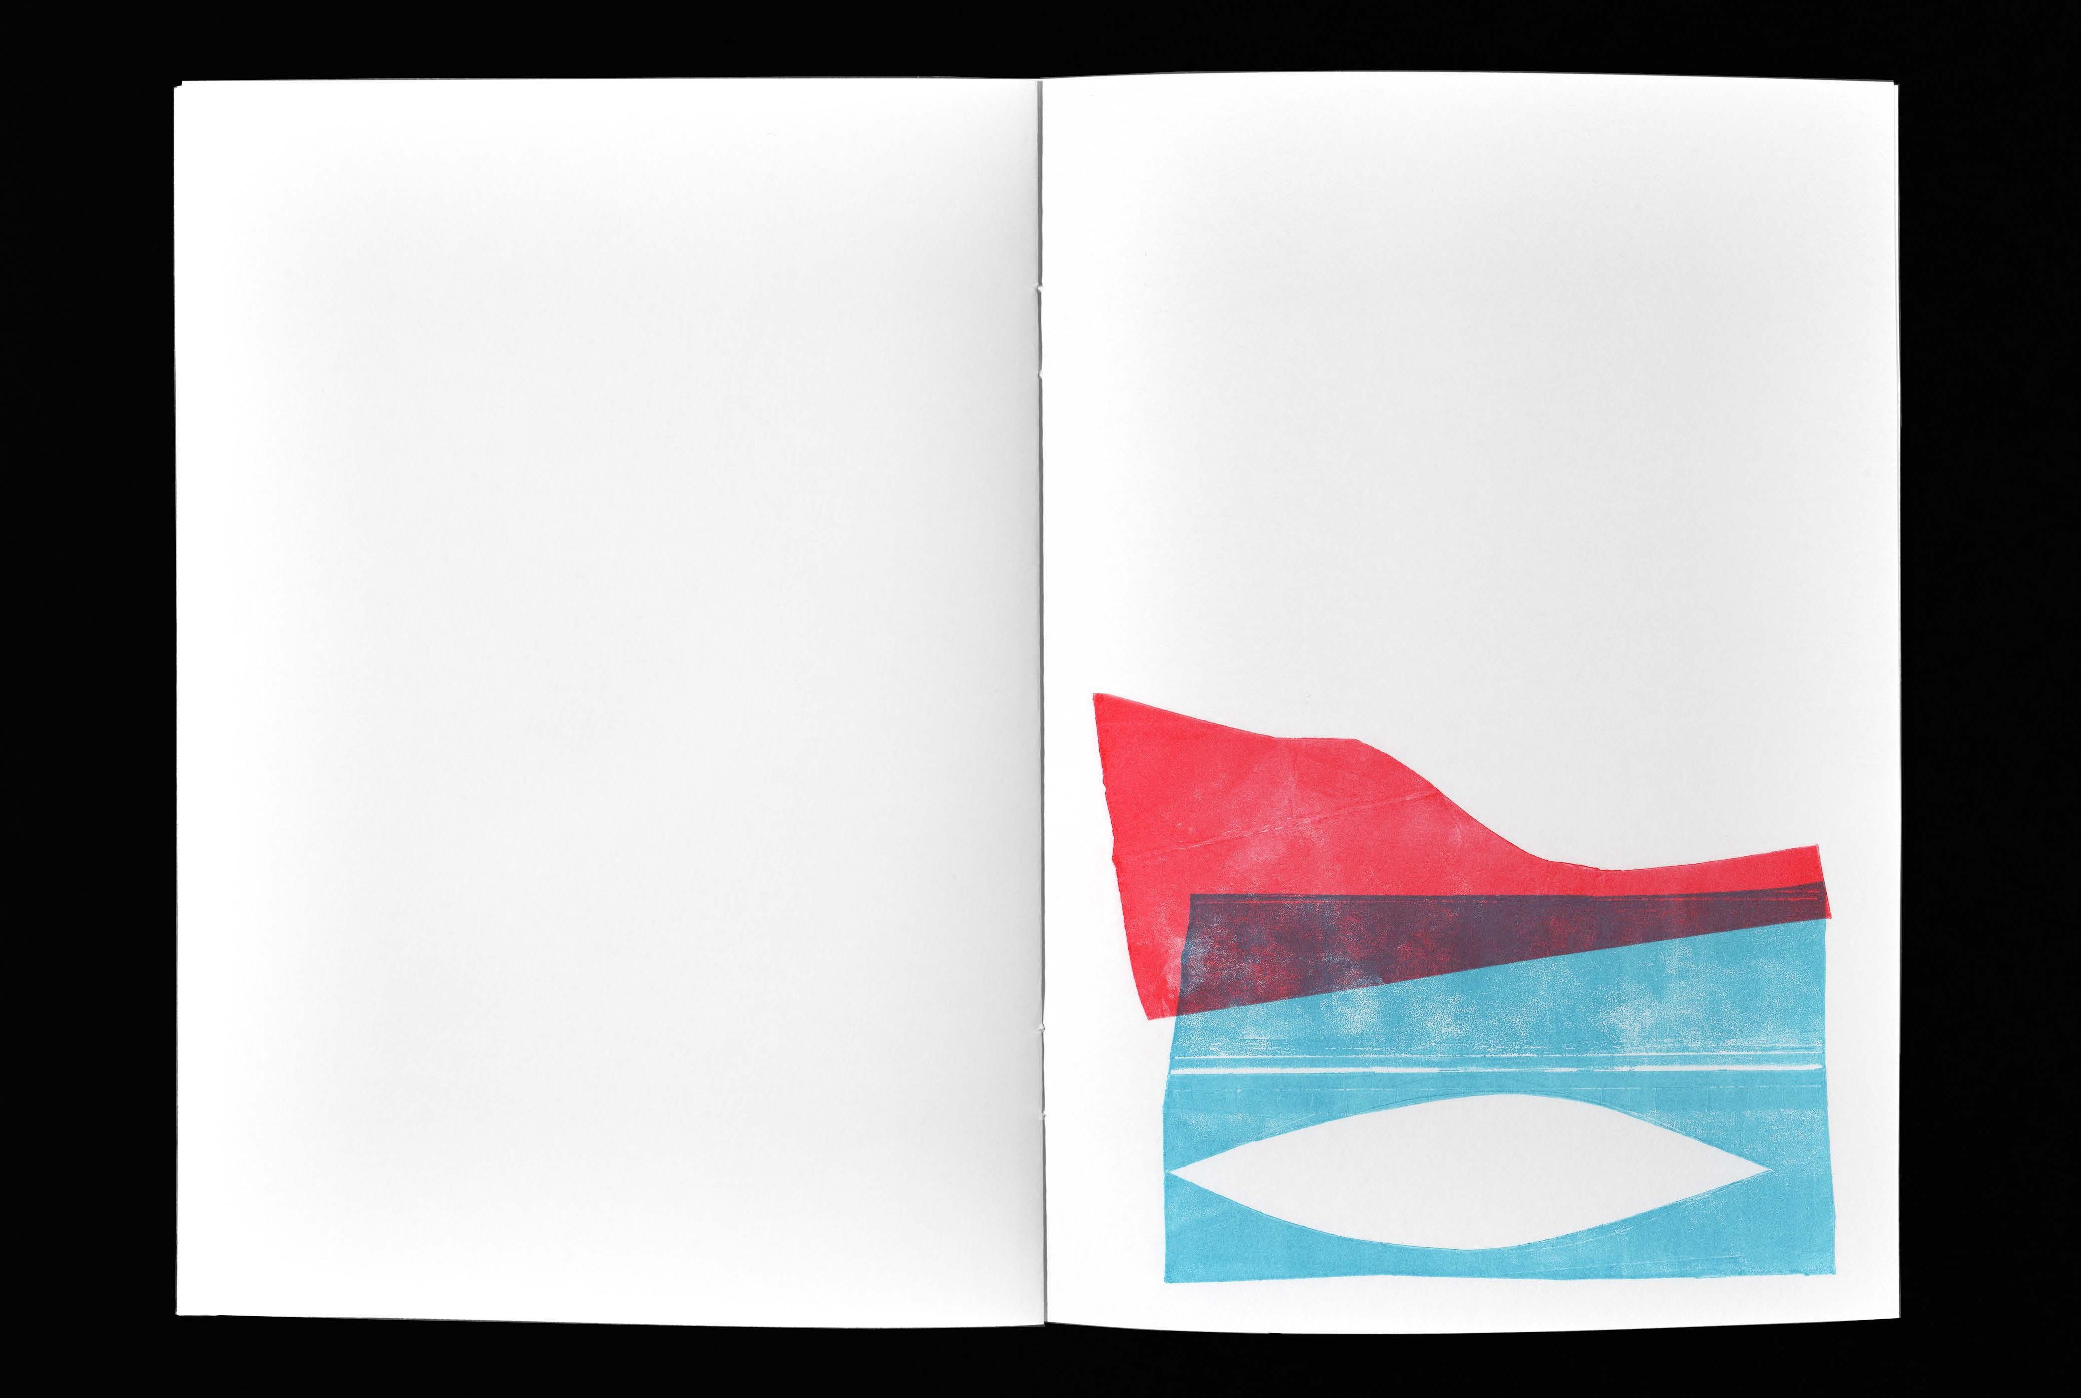
Purple stitches of eightyone years in time. Garments, costumes, curtains.
Hands of embroidery, diminutive techniques.
Feet of braiding, scratching threads of island fibers. Bird’s eye view from the mounrtain tops to the sea. Busy.

Slide 4
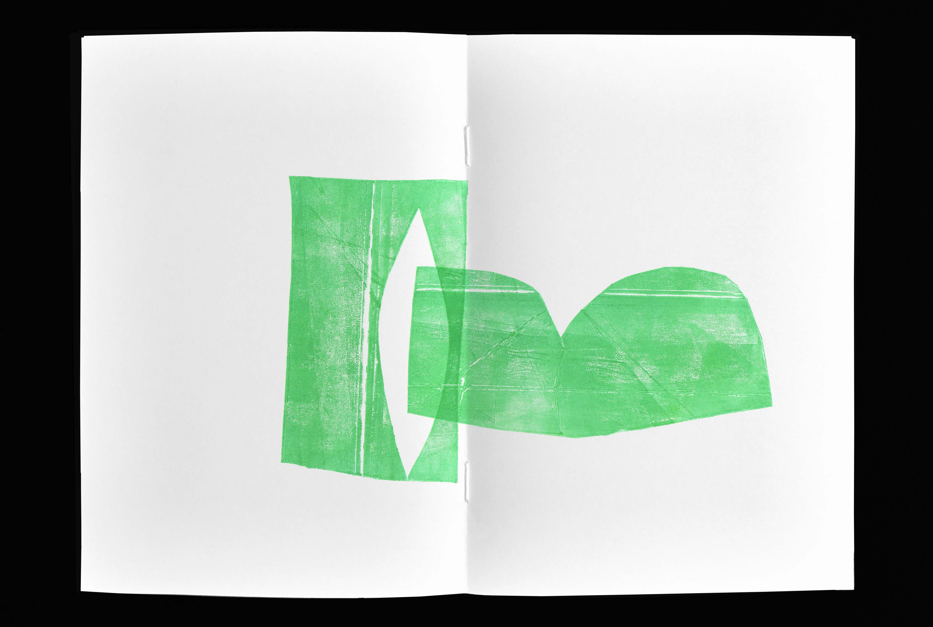
For days on end she danced mazurkas, seis, décimas and aguinaldos; brought babies into the world.
Hers and other’s.

Slide 5
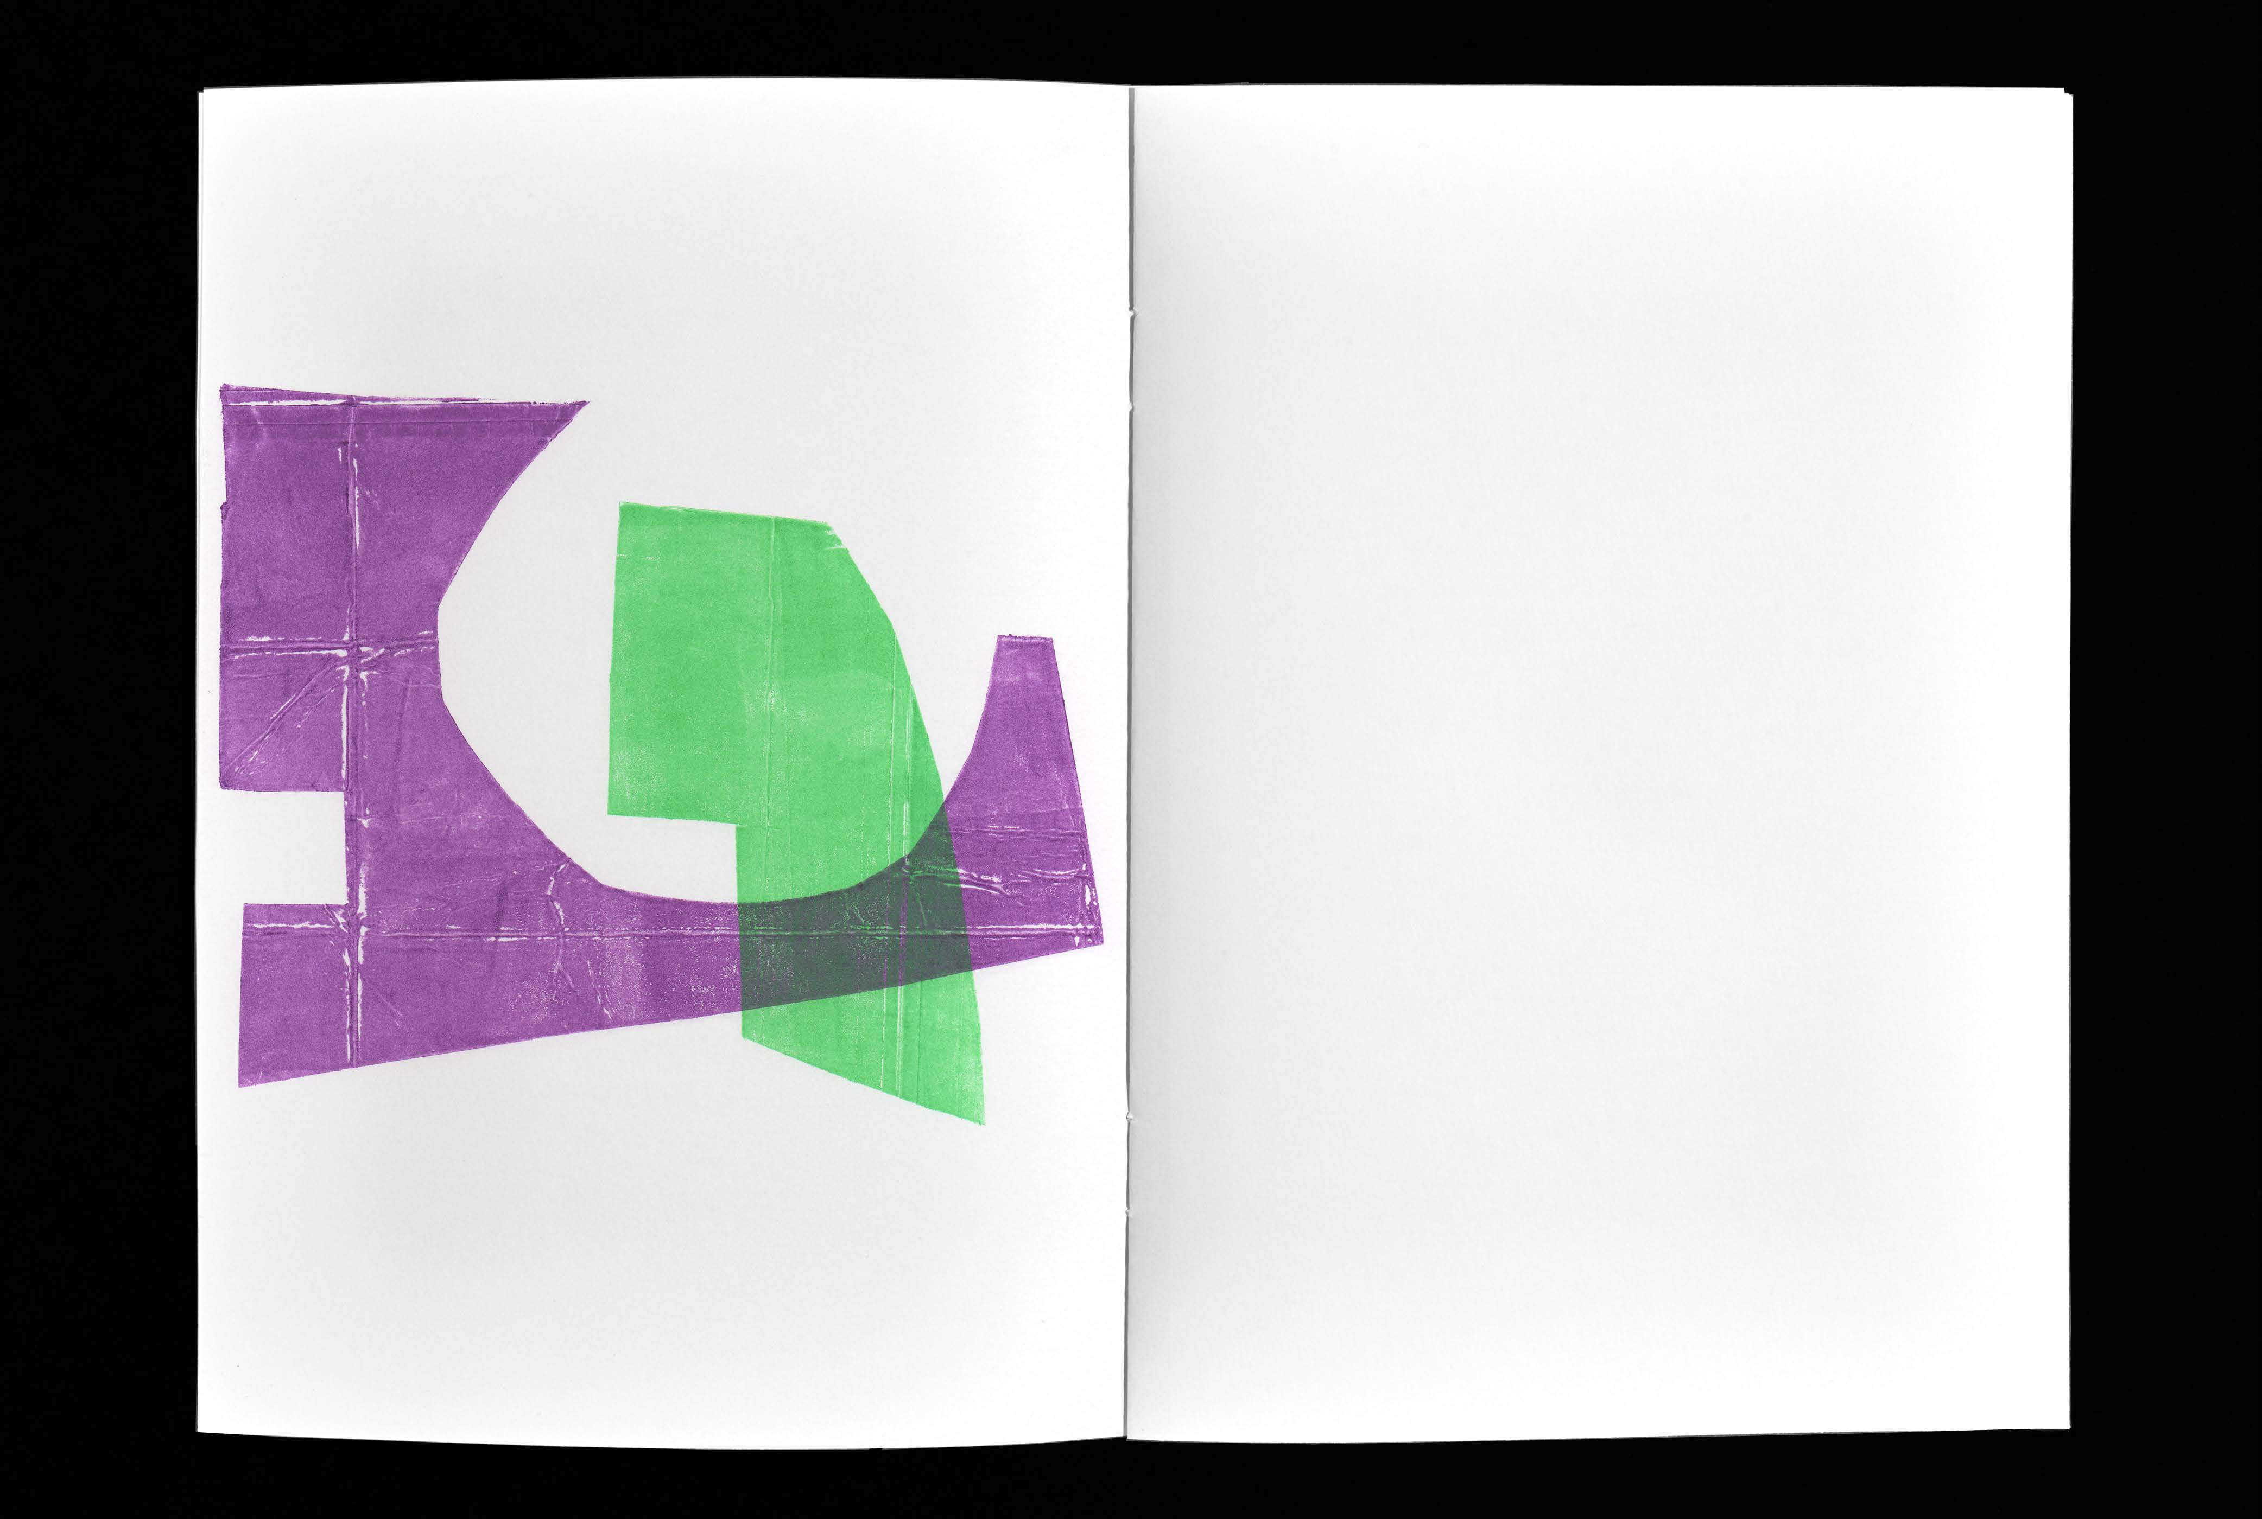
Always I say: everything is movement and sound, start in stillness and silence.
Zero is the possibility of all.

Slide 6
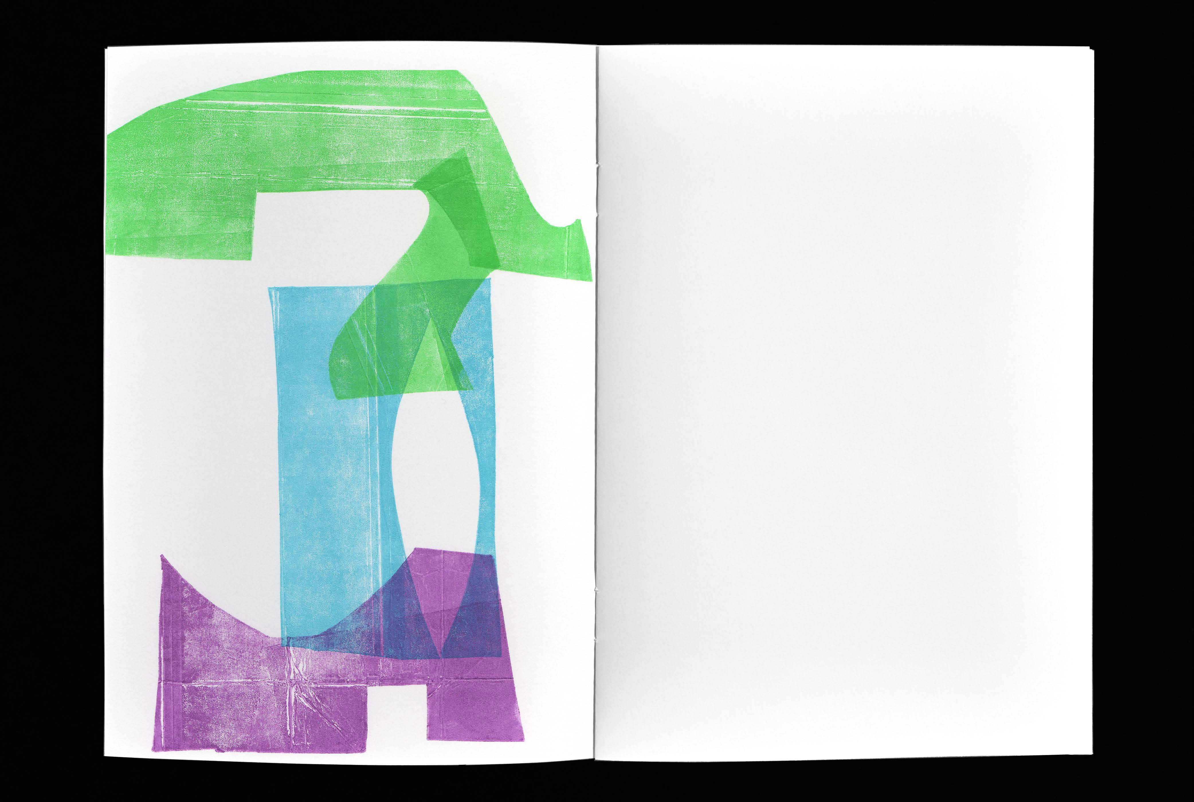
mmmmmmmmmmmm nnnnnnnnnnnnnnnnnnnnnnn hhhhhhhhhhhhhhhhhhhhhhhhhhhhh

Slide 7
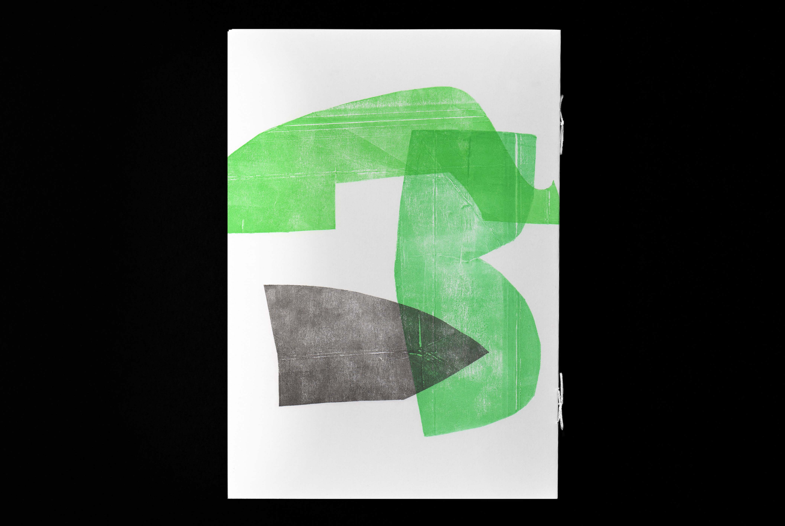
Projeto “Ordem Inversa” www.andreaebert.me/ordem-inversa

